Slide 1
Tax Law Changes 2019

Slide 2
Lesson Topics
Inflation adjustments
Law changes
Pending developments
Scope changes

Slide 3
Standard Deduction Inflation Adjustments
Pub 4012 Tab F-1
Standard deduction increased to
$24,400 MFJ and QW
$18,350 HoH
$12,200 Single and MFS
Additional standard deduction amount for age 65 and older and/or blind increased
$1,650 S, HoH
$1,300 MFJ, MFS, QW (no change)

Slide 4
Standard Deduction Single Dependent Under 65
Pub 4012 Tab F
Dependent standard deduction is the greater of
$1,100 or
Earned income plus $350 not to exceed standard deduction for filing status
Single $12,200
Standard deduction worksheet for dependents in Volunteer Resource Guide (Pub 4012)
Notes:
See Pub 4012 Tab F-2 for dependent standard deduction worksheet

Slide 5
Filing Threshold
Pub 4012 Tab A Chart A
Filing thresholds for most taxpayers is their standard deduction
See exceptions in footnotes to Chart A
Also see Chart C for other situations that must file
Filing threshold increased by additional standard deduction amount due to age 65 or older
Filing threshold not increased by additional amount for blindness
Notes:
Dependent filing threshold Pub 4012 Tab A Chart B

Slide 6
Qualifying Relative Gross Income Test
Personal or dependent exemption deduction reduced to $0 through 2025
$4,200 used for qualifying relative gross income test
Notes:
Dependents still claimed on return, however exemption amount reduced to $0. Dependents used for HoH filing status, EIC, CTC, etc.

Slide 7
Other Inflation Adjustments
Pub 4012
Earned income credit – Tab I
Student loan interest income phase out –Tab E
Standard mileage rate – Tab D (business income) and Tab F
Education credits income phase out – Tab J
Foreign earned income exclusion (international certification required)

Slide 8
Other Inflation Adjustments
Pub 4012
Income limits on IRA deductions – Tab E
Qualified business income (QBI) deduction thresholds – Tab F
$321,400 for MFJ
$160,725 for MFS
$160,700 for single or HoH
Scope: if taxable income (before the QBI deduction) exceeds the threshold, return is out of scope
Notes:
New box 5 1099-DIV for section 199A dividends eligible for QBI

Slide 9
Other Inflation Adjustments
Pub 4012
Health savings account contribution limits – Tab E
Limit on long term care insurance deduction – Tab F
Kiddie tax kicks in at $2,200 of unearned income (after the filing threshold is met) – Tab H
ACA: federal poverty lines updated for premium tax credit purposes – Tab H

Slide 10
No Inflation Adjustment
Pub 4012
Refundable portion of child tax credit – Tab G
Stays at $1,400

Slide 11
Expensing Cost of Goods
Cash basis taxpayers can expense their purchases effective 1/1/2018
Enter as supplies or “other expenses” (not in cost of goods sold)
Cost of goods sold section of Schedule A remains out of scope

Slide 12
Alimony – New or Modified
Alimony treatment for new or modified* orders after 12/31/18
Alimony payments not deductible
Alimony received not taxable
Not compensation for IRA purposes
*Modification must specify that new rules intended to apply
Notes:
Modified orders will apply new law if stated in the modification

Slide 13
Alimony – Grandfathered
Alimony under existing orders are grandfathered
Alimony payments continue to be deductible
Alimony received continues to be taxable
Compensation for IRA purposes
Notes:
Modified orders will apply new law if stated in the modification

Slide 14
Medical Expenses
AGI threshold for deducting medical expenses
10% for everyone

Slide 15
ACA
Shared responsibility payment amount and percentage reduced to zero beginning tax year 2019
No exemptions needed

Slide 16
Kiddie Tax
Legislative proposals made to revert kiddie tax to old law
Would use parents’ return information to determine the child’s tax
Verify current tax law when preparing kiddie tax returns
Notes:
Vincent Workbook problem deals with Bogart calculator and Pell grant

Slide 17
Medicaid Waiver Payments and Credits
June 2019 Tax Court decision allowed taxpayer to include MWP as earned income for EIC
Also applied to additional child tax credit
Awaiting IRS guidance for 2019
IRS has not revised Notice 2014-7
Verify current tax law when preparing returns with Medicaid waiver payments
Notes:
Tax Court decisions do not change IRS regulations and the IRS has not issued any changes to IRS Notice 2014-7 at this point - Medicaid waiver payments are still excluded as earned income. If there are changes, NTTC will issue guidance.

Slide 18
In Scope for 2019
Form 1099-INT boxes 10 through 13
TaxSlayer input screen enhanced
Type what you see*
* Box 13 exception: reduce Box 8 exempt interest by amount in box 13 – see lesson 12 Interest and Dividend income

Slide 19
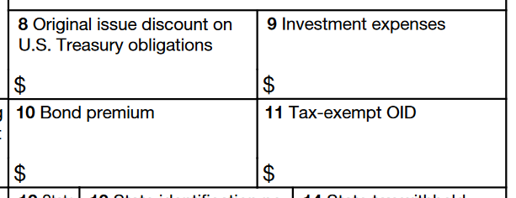
In Scope for 2019
Form 1099-OID boxes 8 through 11
TaxSlayer input screen enhanced
Type what you see
See lesson 12

Slide 20
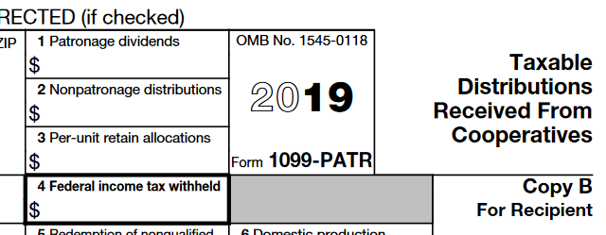
In Scope for 2019
Form 1099-PATR box 1
Must be for personal (nonbusiness) use purchases
Dividends are not taxable and not reportable
No need to input into TaxSlayer
Notate in the intake booklet

Slide 21
Expired Benefits (Still) Not Renewed
Deduction for private mortgage insurance (PMI)
Exclusion from gross income of qualified principal residence indebtedness cancelation
Deduction for qualified tuition & fees
Credit for nonbusiness energy property (residential energy credit)
Remaining Form 5695 residential energy credits out of scope

Slide 22
Form Changes
1040 and schedules redesigned
New 1040-SR (1040 with larger print)
Schedule C-EZ and F2555-EZ obsolete
No longer necessary to force Schedule C
Form 8965 (ACA exemptions) obsolete
No shared responsibility payment beginning 2019

Slide 23
Tax Law Changes

